Slide 1


IIT Kharagpur Advance Technology Development Centre
Topic – Solar Based Charger
Submitted By
Mohd Ali Shamsi (24AT62R02)
Himanshu Sinha (24AT62R06)
Submitted as
Fulfillment of
Assignment
Submitted to
Prof. Dipankar Debnath

Slide 2
Index
Intro to Solar Panels
Need for solar integration ?
Basics of Solar
How to integrate with charger ?
Control Strategy
MATLAB Model
Simulation Results
Challenges faced in the Solar Integration.
Ongoing Research
Future Scope
Conclusion

Slide 3
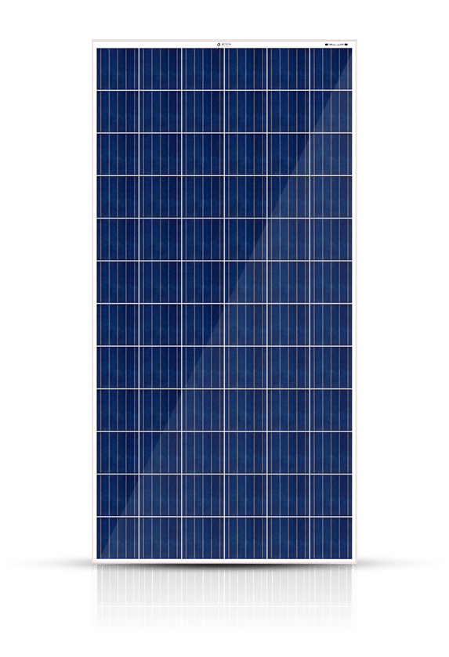
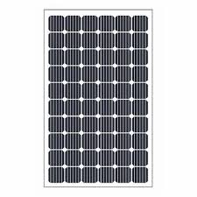
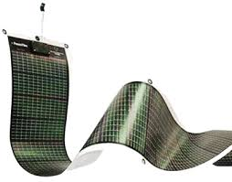
Intro to Solar Panels
Solar Panels convert the solar energy to electrical energy
The solar panels work on Photovoltaic Effect, meaning some material when faced to sunlight generate Electricity.
Types of Solar Panels :
Monocrystalline
Polycrystalline
Thin-Film
Monocrystalline Solar PV
Polycrystalline Solar PV
Thin-Film Solar PV

Slide 4

Need for Solar Integration ?
Enhanced Range and Flexibility
Sustainable Energy Use
Cost Savings Over Time
Increased Grid Resilience
Convenient Charging in Remote Locations
Battery Health and Energy Management
Supporting Renewable Energy Goals
Contributing to Smart Mobility Ecosystems

Slide 5
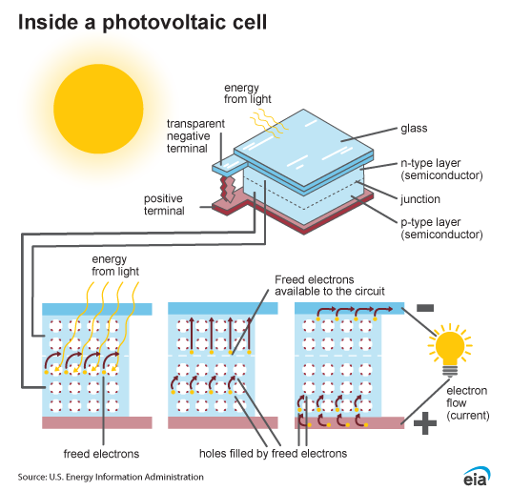
Basics of Solar

Slide 6
Basics of Solar?
Dark
i_{p}
i
a
i
i_{p1}
<
i_{p2}
i_{d}
Dissipation
V_{ak}
V_{ak}
i_{p1}
Generation
i_{p2}
Maximum Insolation
k

Slide 7
Basics of Solar?
i_{p}
i
i
I_{sc}
R_{se}
I_{m}
P_{m}
i_{d}
i_{sh}
R_{sh}
V_{m}
V_{OC}
V_{ak}
V_{ak}
Just Flip the y-axis !!!!
k

Slide 8

Basics of Solar?
i_{p}
i
From the mode,
i_{p} = i_{d} + i_{sh} + i
Where, i_{d} = I_{o}($e^{\frac{Vak+i∗Rse}{γVT}}$ - 1)
i_{sh} = $\frac{Vak+i∗Rse}{Rsh}$ also, V_{T} = KT/q
K = Boltzmann
constant
Open Circuit Voltage, V_{OC} = γ V_{T} ln($\frac{ip}{Io}$ + 1)
Short Circuit Current, I_{SC} = i_{p}
R_{se}
i_{d}
i_{sh}
R_{sh}
V_{ak}
k

Slide 9
Dependance of Solar cells
Irradiation
The I-V and P-V curve are gradually shifted along the Irradiation
If Irradiation is low I-V and P-V Curves are shifted downward.
I₁
>
I₂
>
I₃
i
I_{sc}
I₁
I_{m}
I₂
I₃
Temperature
Higher Temperature results in low V and low P.
Thus shifting the graph to the left.
V_{m}
V_{OC}
V_{ak}
T₁
>
T₂
>
T₃
i
I_{sc}
I_{m}
V_{m}
V_{OC}
V_{ak}

Slide 10
Method to Get Pm
Method 1
Applying Temperature and Irradiance sensor to estimate V_{m} .
Method 2
Measuring V_{ak} , I
Applying Algorithms like P & O etc to track and set V_{m}
V_{ak}
MPPT Algorithm
V_{ref} = V_{m}
I

Slide 11
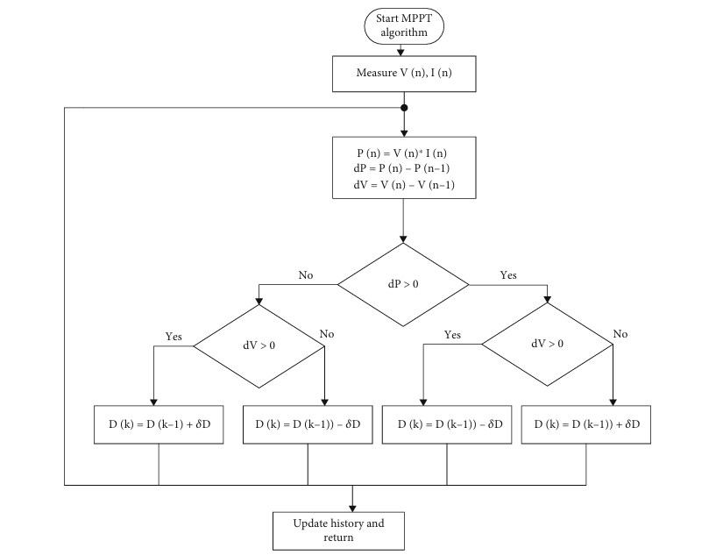
Flowchart for MPPT
Credits - Harrison, Ambe, Nfah, Eustace Mbaka, de Dieu Nguimfack Ndongmo, Jean, Alombah, Njimboh Henry, An Enhanced P&O MPPT Algorithm for PV Systems with Fast Dynamic and Steady-State Response under Real Irradiance and Temperature Conditions, International Journal of Photoenergy, 2022, 6009632, 21 pages, 2022

Slide 12
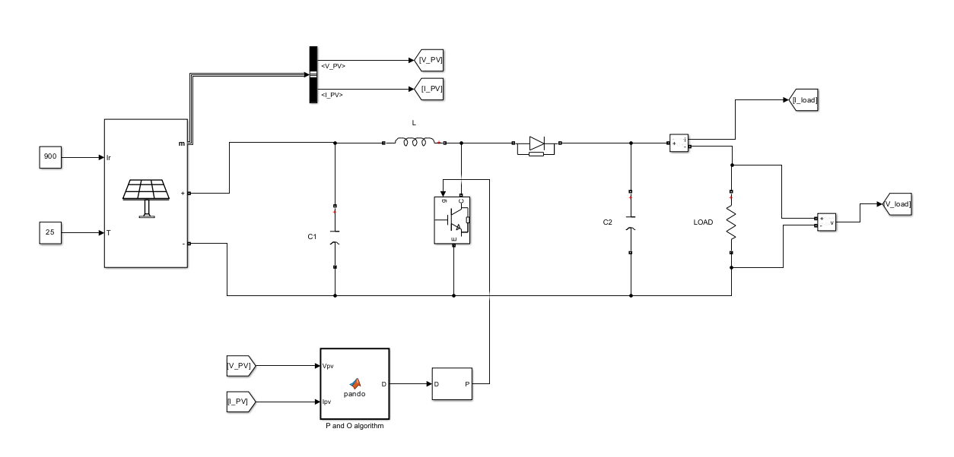
MATLAB Simulation

Slide 13
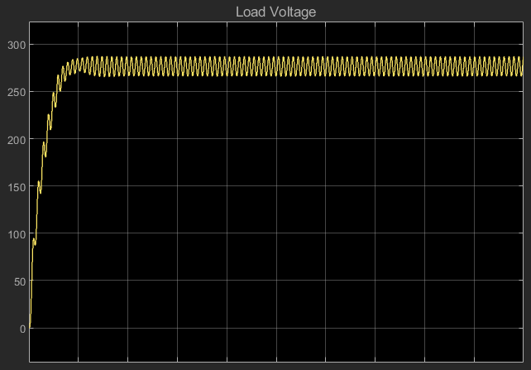
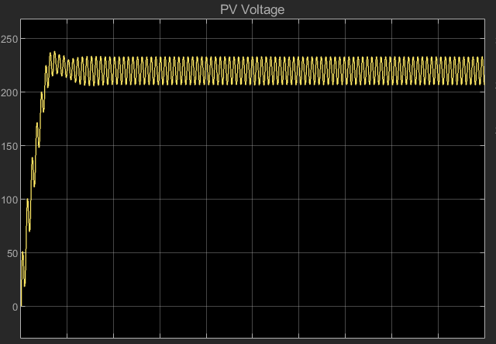
MATLAB Simulation

Slide 14
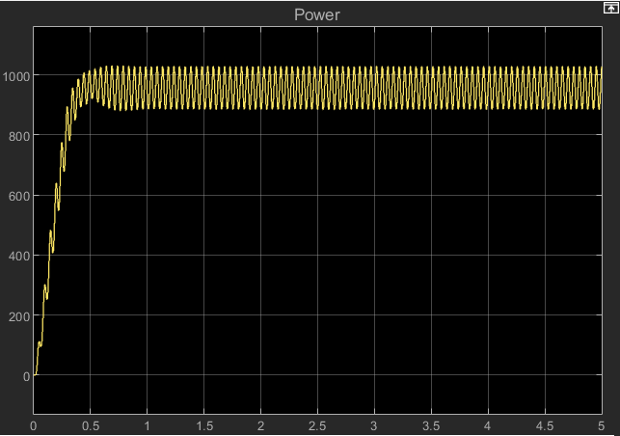
MATLAB Simulation

Slide 15
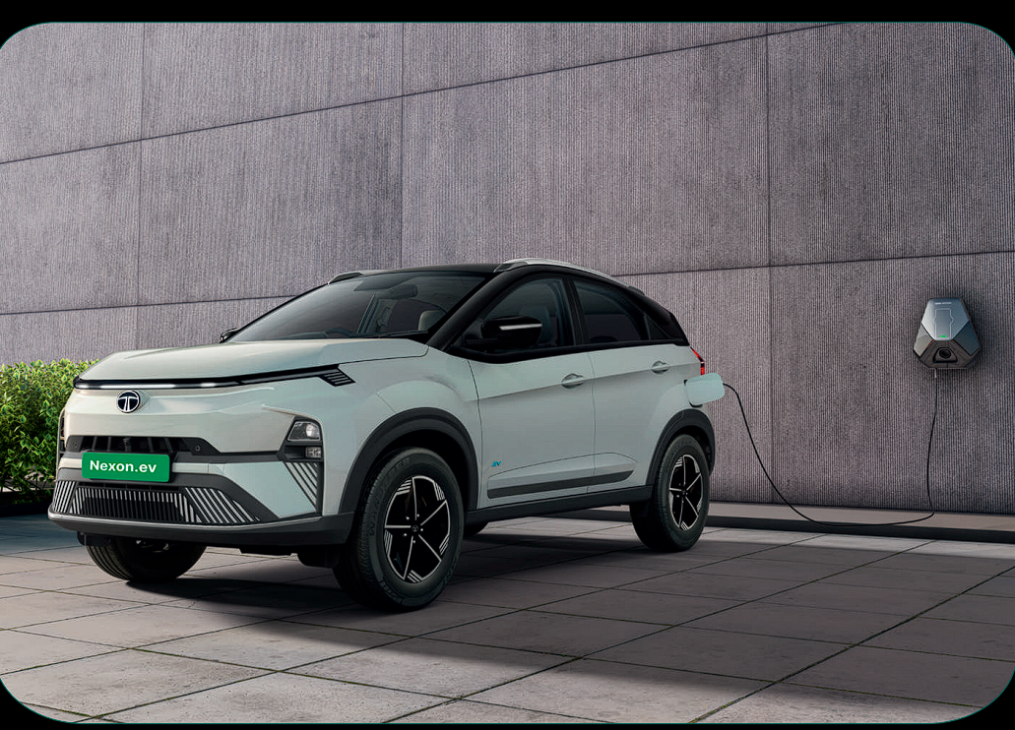
Specification of Vehicle
Vehicle Company – Tata Motors
Vehicle Model – Tata Nexon EV
Battery Pack Capacity – 40.5kWh
Nominal Battery Voltage – 320V.
Certified Full Charge Range – 390 km.
Electric Motor Power – 110kW
Electric Motor Torque – 210Nm

Slide 16

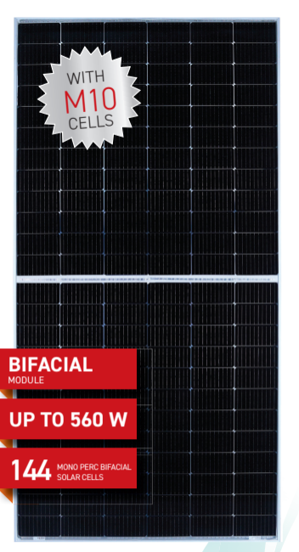
Specification of Solar Panel
Company – Vikram Solar
Solar Type – 782 IBC monocrystalline silicon
solar cell
Weight of PV panel – 29Kg
Efficiency – 21%
Maximum Power Voltage – 41.6 V
Maximum Current - 12.87 A
Open Circuit Voltage – 49.5 V
Short Circuit Current – 13.56 A
Tc of open circuit voltage - -0.27%/˚C
Rs 13000/-

Slide 17
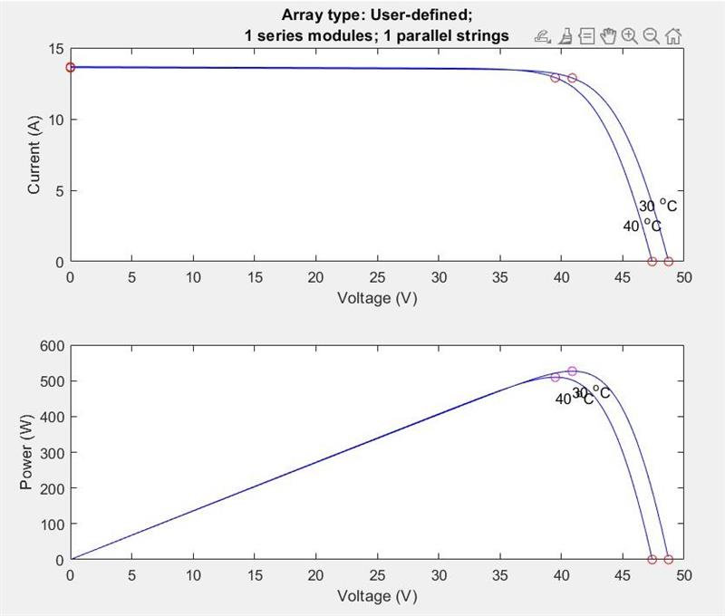
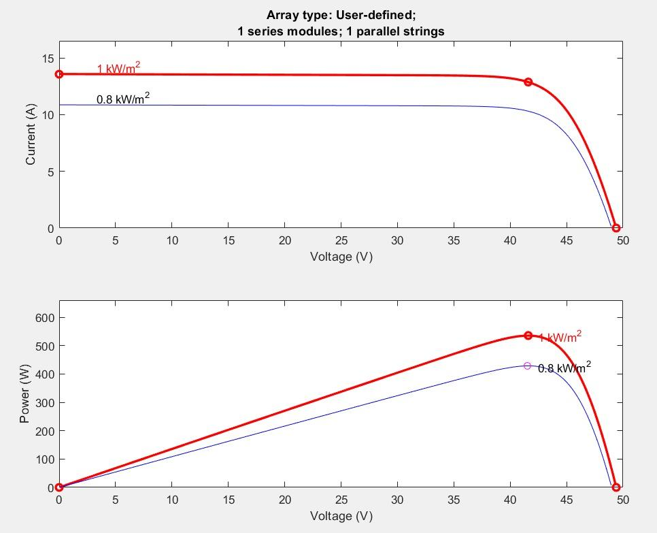
Specification of Solar Panel

Slide 18
Estimation of Daily Solar Savings
Input Energy to Solar = Solar Irradiation * 0.7
Output Energy from Solar = Input Power to Solar x Efficiency.
Cost of that Energy (Kolkata) = Energy Consumed from Solar x Unit Rates.
This estimation results in saving of approx. = Rs. 2200/year-
The amount invested in panel would be probably back in 7 years or less.

Slide 19
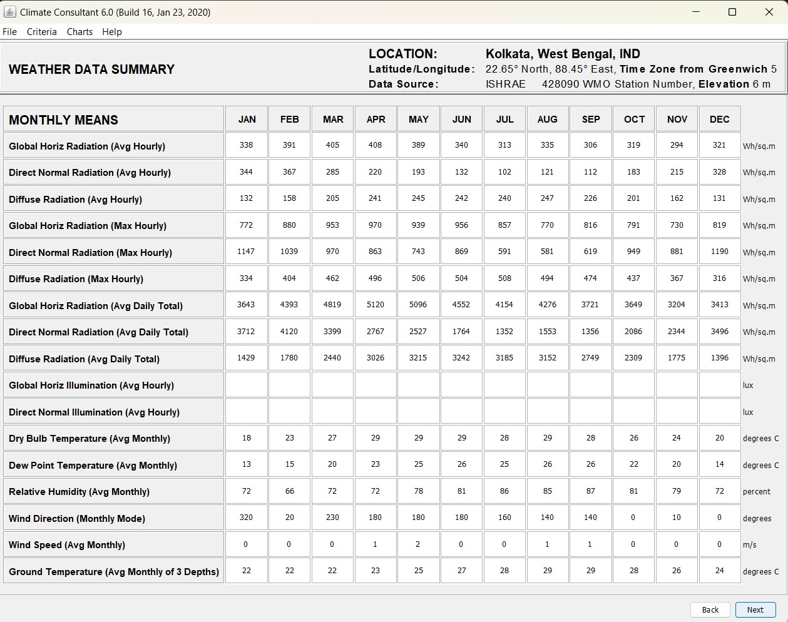
Estimation of Daily Solar Savings

Slide 20
Estimation of Daily Solar Savings
Months | Solar Irradince Data/per day | Energy Outputed by Solar (Wh) | Cost of Electricty Saved Per Day | Cost Saved per Month
Jan | 3712 | 1407.112487 | 8.794453046 | 272.6280444
Feb | 4120 | 1561.773558 | 9.761084739 | 273.3103727
Mar | 3399 | 1288.463186 | 8.05289491 | 249.6397422
Apr | 2767 | 1048.890154 | 6.555563464 | 196.6669039
May | 2527 | 957.9130538 | 5.986956586 | 185.5956542
Jun | 1764 | 668.6816885 | 4.179260553 | 125.3778166
July | 1352 | 512.5043327 | 3.203152079 | 99.29771446
Aug | 1553 | 588.6976544 | 3.67936034 | 114.0601705
Sep | 1356 | 514.0206177 | 3.212628861 | 96.37886582
Oct | 2086 | 790.7426317 | 4.942141448 | 153.2063849
Nov | 2344 | 888.5430147 | 5.553393842 | 166.6018153
Dec | 3496 | 1325.233097 | 8.282706856 | 256.7639125

Slide 21

Estimation of Drive Range Extension
Input Energy to Solar = Solar Irradiation * 0.7
Output Energy from Solar = Input Power to Solar x Efficiency.
Range estimation = $\frac{390km ∗Output Solar Energy}{40kW x 8}$
This estimation results in an increase in drive range average of 15km.

Slide 22
Estimation of Daily Solar Savings
Months | Solar Irradince Data/per day Wh/m² | Amount of Solar Radiance Avaliable to EV (Wh/m²) | Input SolarEnergy to PV (Wh) | Energy Outputed by Solar (Wh) | Range Estimation
Jan | 3712 | 3712 | 9572.193792 | 2010.160696 | 17.28738199
Feb | 4120 | 4120 | 10624.30992 | 2231.105083 | 19.18750372
March | 3399 | 3399 | 8765.055684 | 1840.661694 | 15.82969057
April | 2767 | 2767 | 7135.307172 | 1498.414506 | 12.88636475
May | 2527 | 2527 | 6516.415332 | 1368.44722 | 11.76864609
June | 1764 | 1764 | 4548.855024 | 955.259555 | 8.215232173
July | 1352 | 1352 | 3486.424032 | 732.1490467 | 6.296481802
Aug | 1553 | 1553 | 4004.745948 | 840.9966491 | 7.232571182
Sep | 1356 | 1356 | 3496.738896 | 734.3151682 | 6.315110446
Oct | 2086 | 2086 | 5379.201576 | 1129.632331 | 9.714838046
Nov | 2344 | 2344 | 6044.510304 | 1269.347164 | 10.91638561
Dec | 3496 | 3496 | 9015.191136 | 1893.190139 | 16.28143519

Slide 23
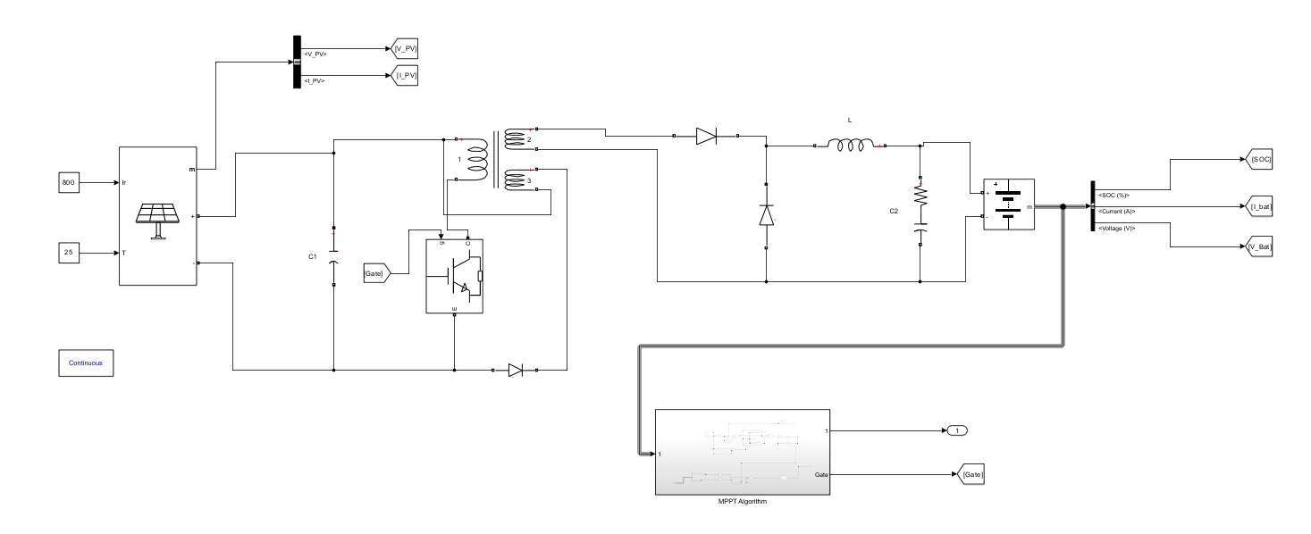
MATLAB Simulation

Slide 24
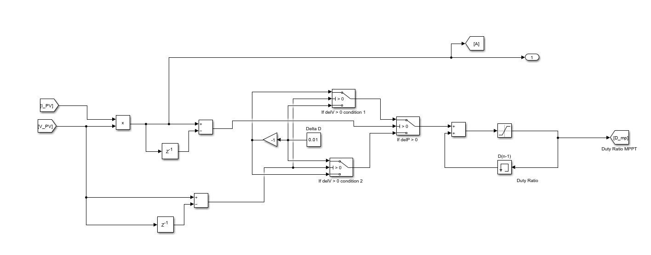
MATLAB Simulation

Slide 25
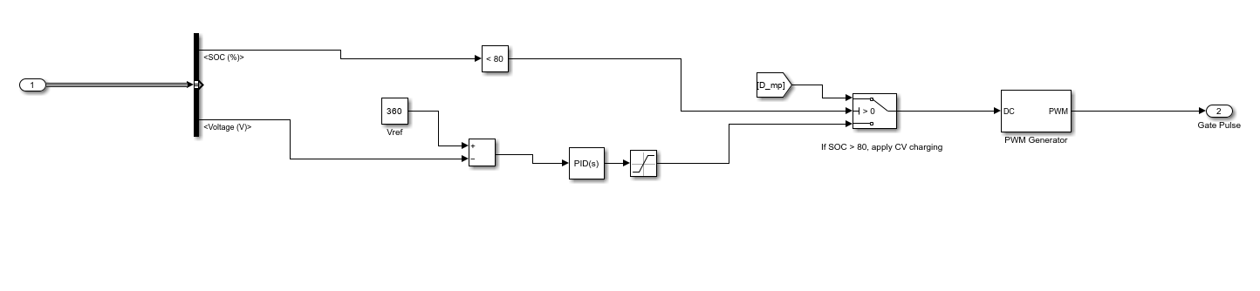
MATLAB Simulation

Slide 26
Recent Advancement in Solar Technology
Perovskite Solar Cells
Shown remarkable improvement in efficiency of 25 %
Lightweight & Flexible.
Tandem Solar Cells (Perovskite + Silicon)
Capture Broader Spectrum of Sunlight. Efficiency 30%
Long-Term Stability.
Bifacial Solar Panels with Tracking Systems
Dual-Sided
Increase energy generation buy 10-20%
Machine Learning and AI for Optimization
Predictive Performance Management
Dynamic Adjustments for EV Applications
Quantum Dot Solar Cells
Good output in less sun exposure.
Good performance under diverse lightening.

Slide 27
Conclusion
We have gone through the basics of PV cells
The Basic knowledge is been verified or reflected in the MATLAB simulation model for MPPT
We have also done theoretical case study for Tata Nexon EV.
Several factors underlying our theoretical evaluation are discussed.
We have thus evaluated data and estimated the cost and benefit of installing solar pv cells.

Slide 28
Thank you !!!

